Slide 1
HIV and CBR in Saskatchewan
SK Education Series: 23 November 2016
Sugandhi del Canto, SHARE

Slide 2
Overview of presentation
Who is SHARE and what do we do?
Quick review: What is Community-Based Research (CBR)?
Why is CBR important in HIV research?
Moving an idea into a funded project: What are the steps?
SK examples: A tale of two grants
A few lessons learned
Notes:
This session will look at the experience of developing a community-based research grant, such as how key players were identified, how research questions were defined and all the nebulous steps in between. Using specific examples, Sugandhi will describe what it's like to develop a community-based research project when working with diverse stakeholders - specifically, what she learned and how she had to question what she thought she knew. The session will conclude with suggestions for how community-based HIV research can be more robust in Saskatchewan.

Slide 3
Objectives
By the end of this presentation, participants will be able to:
Name and describe the four principles of OCAP
Identify at least two funding sources for HIV CBR projects in SK
Describe a process for engaging with communities to shape CBR

Slide 4
What is share?
Saskatchewan HIV/AIDS Research Endeavour

Slide 5
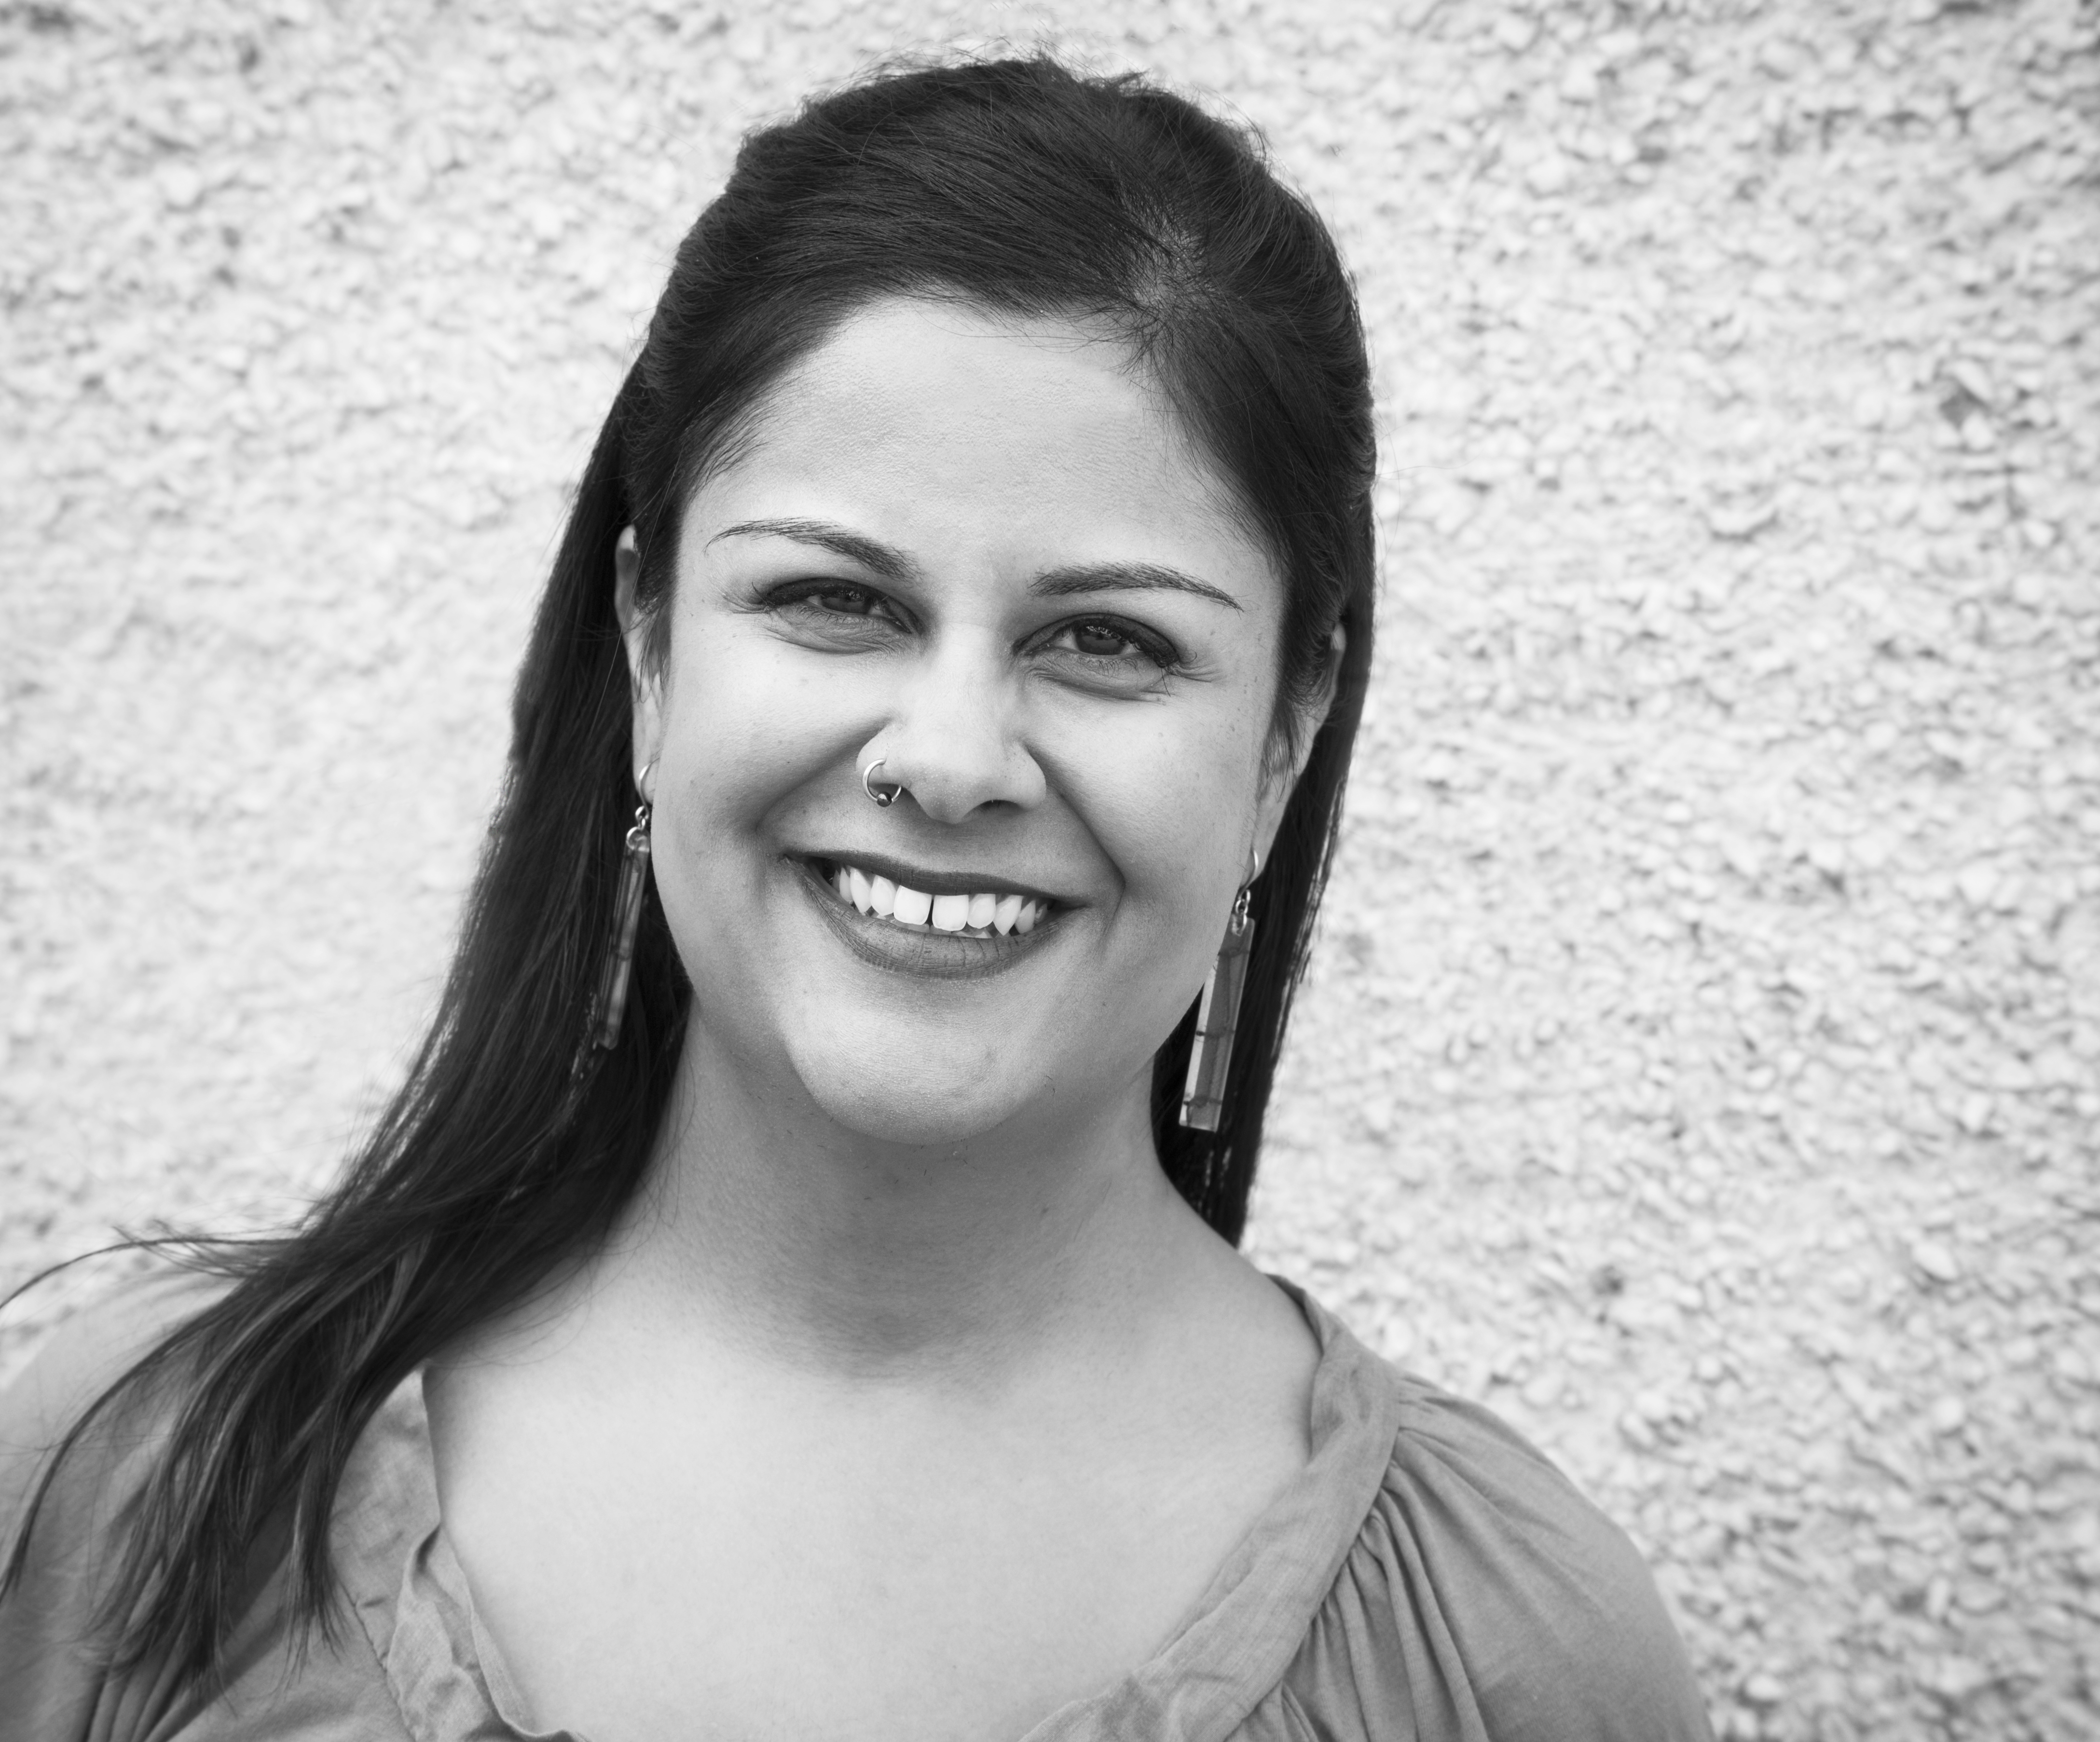
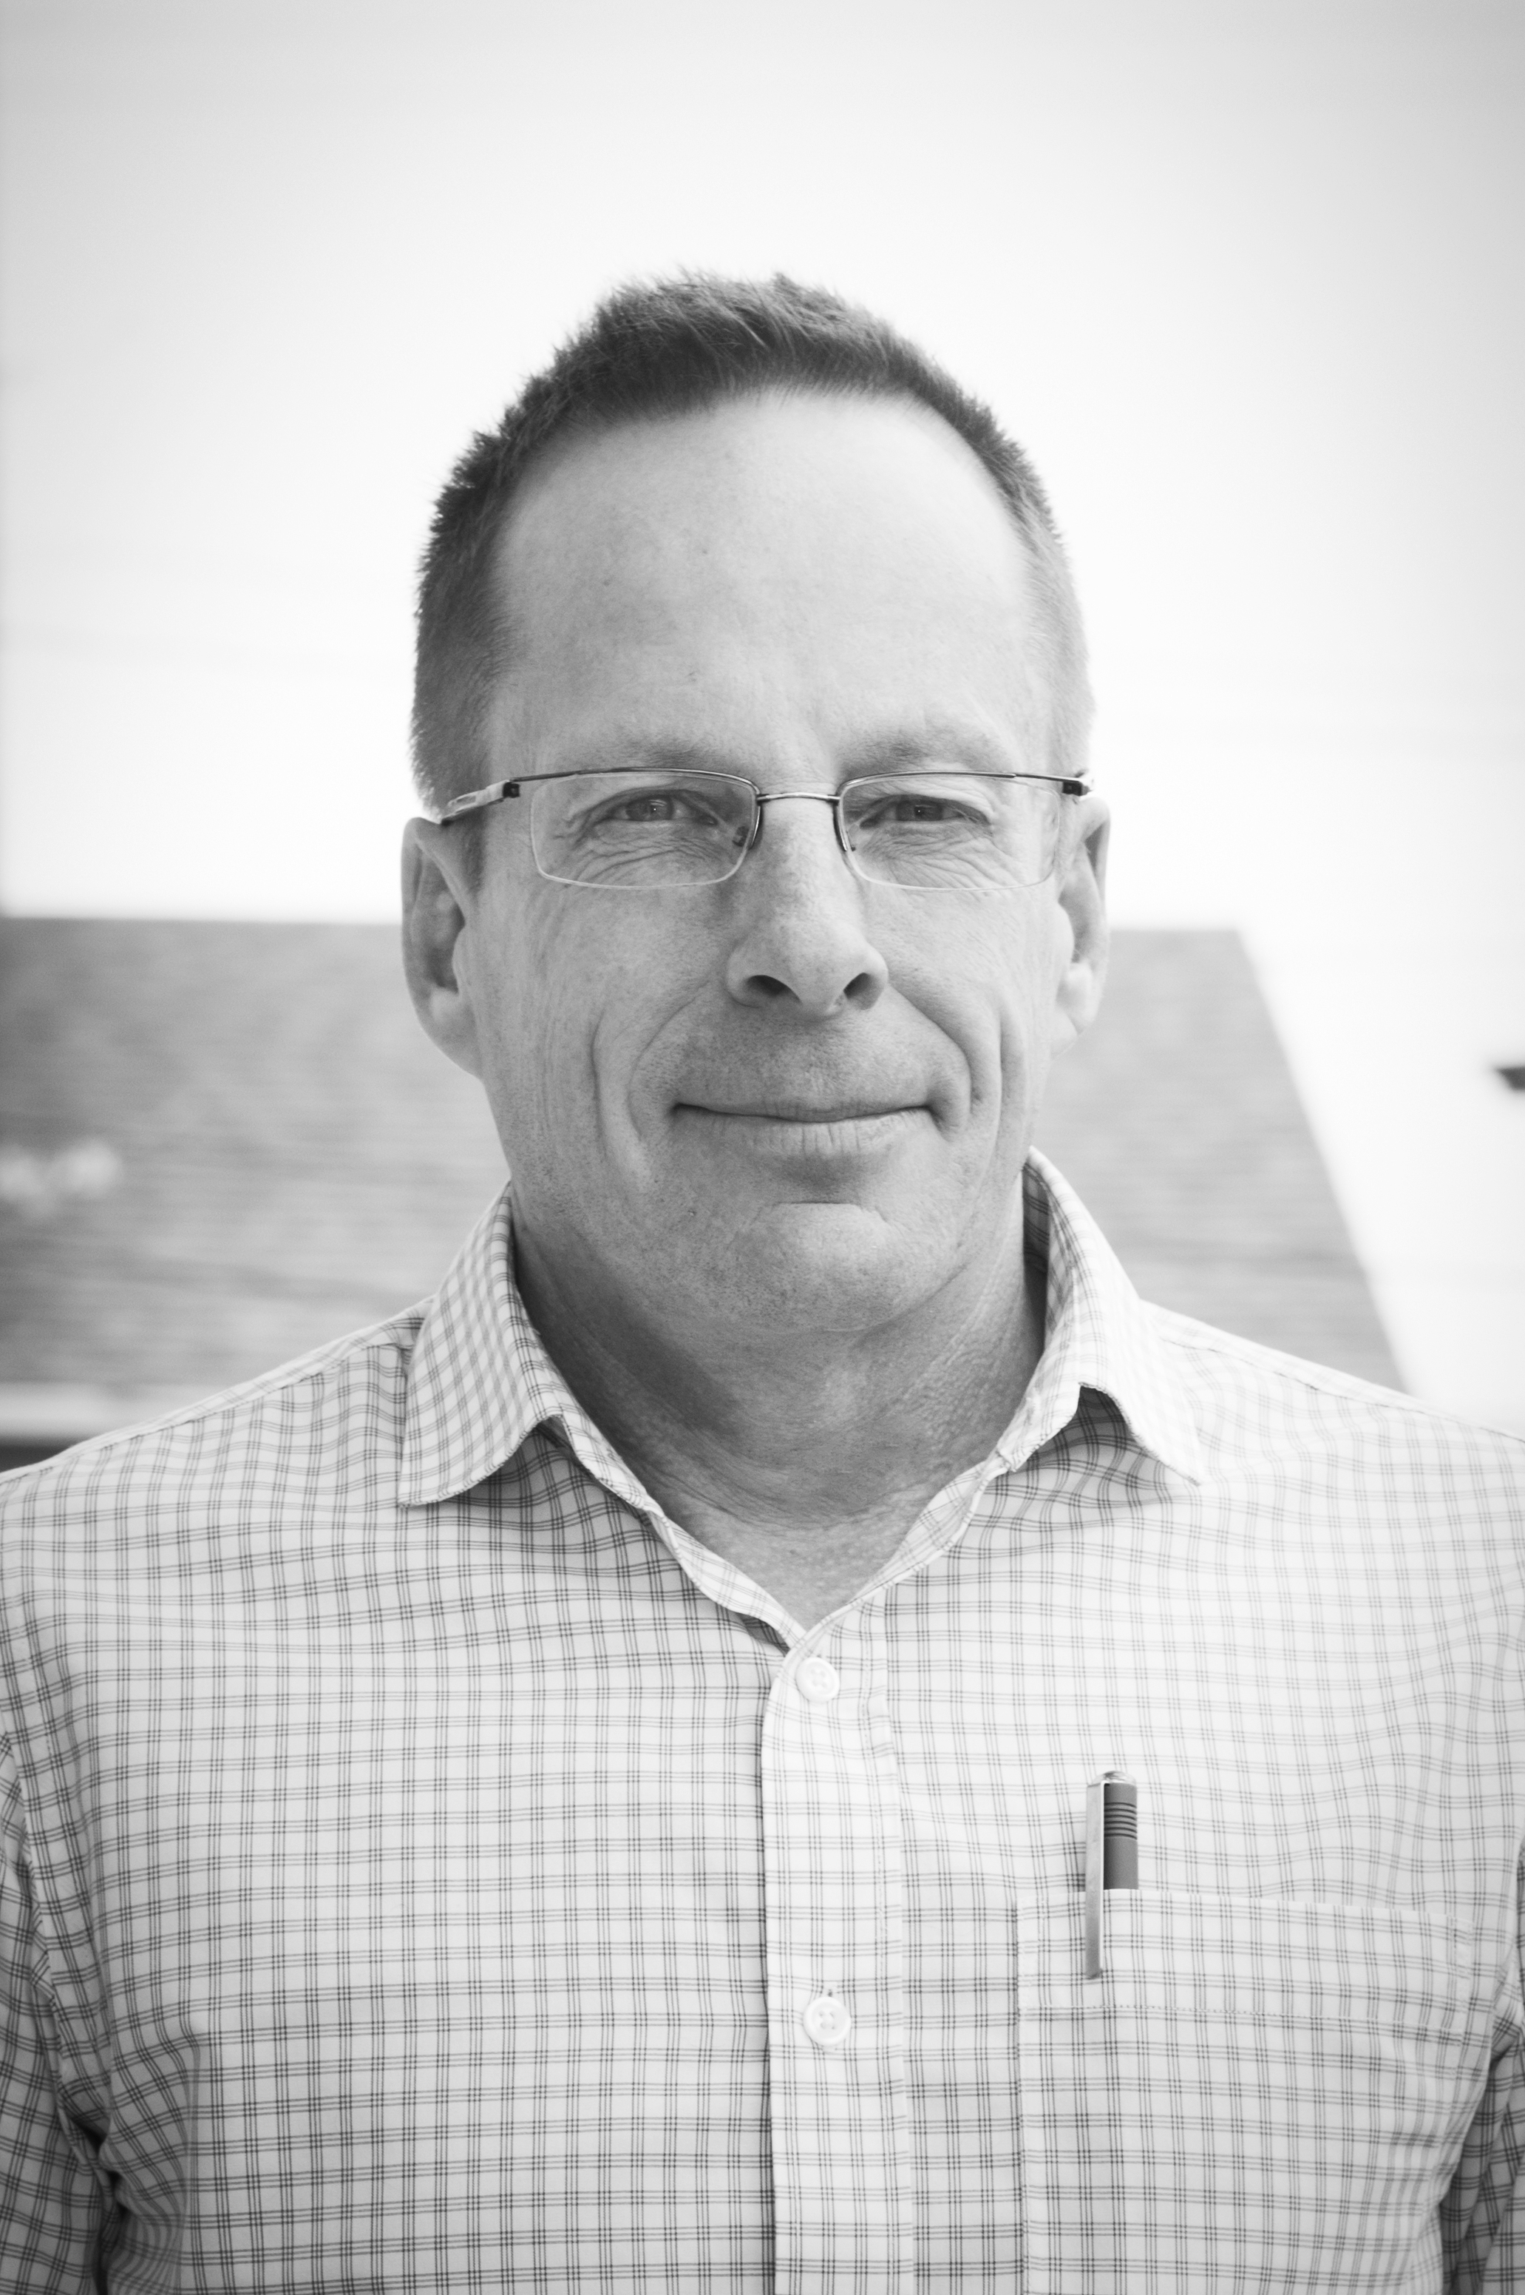
Who is SHARE?
SHARE is a research initiative organized by clinicians and researchers who are invested in building a better response to the HIV epidemic in Saskatchewan.
-www.share-sk.ca
Staff
Sugandhi and Michael
Academic co-leads
Dr. Stephen Sanche
Dr. Kali Gartner
Dr. Ryan Meili
Dr. Kris Stewart
Sugandhi del Canto, Executive Director
Michael Quennell,
CBR Associate

Slide 6
What does SHARE do?
SHARE supports and creates research in 4 key areas:
Community based research
Clinical research
Basic science research
Population health/epidemiology research
SHARE provides guidance and support to other researchers pursuing projects in HIV/AIDS along with creating novel projects executed by the core SHARE team.

Slide 7
Who does SHARE work with?
Local, provincial and national partners
Service providers
Health care professionals
Researchers
People living with HIV
Community-based organizations
Academics

Slide 8
What is cbr?
Community-based Research

Slide 9
OCAP principles
Ownership
Control
Access
Possession

Slide 10

Why is CBR important to HIV work?
Capacity- and skills-building opportunities
Facilitates knowledge to action
Answers questions “from the ground up”
Addresses systemic power imbalances
http://caan.ca/aha-centre/

Slide 11
A few CBR resources
10 evidence-based fact sheets on designing HIV CBR projects
Developing CBR: A Skills-building curriculum
CBR brochure for Community-Based Organizations

Slide 12
Moving from idea to action

Slide 13
Stages of work
Define the research question
Assemble the team
Identify funding sources
Develop a grant
Hope for funding
Don’t be fooled by the numbered list – CBR is never linear!

Slide 14
Defining the research question
What is the issue we want to address?
  Is CBR appropriate?
What questions can we ask to address that issue?
Who is affected by this issue? How do THEY want to address it?

Slide 15
Assembling the team
Identify and select partners
  Find the natural leaders
Honour lived experience (and compensate accordingly)
Establish and maintain trust
Be transparent in communications

Slide 16
Identifying funding
Develop a research proposal in response to a specific funding call
OR
Seek funding to suit your research study

Slide 17
Developing a Grant
Know the criteria
Develop a work plan and assign roles
Set timelines (milestones)
Find a good editor

Slide 18
Hoping for funding
You got funded! Congratulations!
  Notify partners – be certain they still want to go ahead with study
  Get started on the ethics application
  Subsequent steps are specific to the nature of the study
You didn’t get funded. Now what?
  Notify partners – discuss feedback received
  Decide if you will apply elsewhere, or apply again in the next round
  Explore revisions to the research question or study design

Slide 19
Sk examples
A tale of 2 grants

Slide 20
Patient-Provider Toolkit
Funder: Saskatchewan Health Research Foundation (SHRF)
Funding stream: Collaborative Innovation Development grant
Objective: To create an interactive patient-provider toolkit that supports both HIV+ patients and their circle of care providers (doctors, nurses, home care staff, family-based care providers and frontline social service supports, such as addictions counsellors) to improve health outcomes

Slide 21
Allied Professional
Point-of-Care Testing (POCT)
Funder: Canadian Institutes for Health Research (CIHR)
Funding stream: Operating Grant – HIV CBR
Objective: To assess the feasibility and acceptability of allied professionals offering HIV point-of-care testing (rapid tests)*
(*Currently, only nurses, physicians and lab techs can offer rapid tests under present legislation)

Slide 22
Patient-Provider Toolkit
Allied professional POCT
Successes
Funded!
Includes people living with HIV on the research team
Strengthened existing partnerships
Challenges
Engaging health care providers
Defining knowledge translation
Successes
Created an opportunity to develop new partnerships
Started dialogue on CBR needs in SK
Challenges
Defining the research question
Finding an appropriate PI
Working around existing legislation

Slide 23
Lessons learned
An ever-growing list

Slide 24
A few lessons
Saskatchewan is unique in many ways
Be prepared for several iterations of project development
Funding calls are time-specific, relationships are ongoing
Identify potential Principal Investigators and keep a running list

Slide 25
Thank you for your time!
Get in touch with us:
sugandhi@share-sk.ca
michael@share-sk.ca
Tel: 306-979-4444
Website: www.share-sk.ca
Twitter: @SK_HIV_Research

